Slide 1
Analysis and Exploitation of Content-Based Blind SQL Injection
STUDENT NAME : NETHANIEL JOHAN KURIAN 24BCY10210
VAIBHAV SINGH 24BCY10161
ASHUTOSH KUSHWAHA 24BCY10034
COURSE: CYBER SECURITY AND DIGITAL FORENSICS

Slide 2
Problem Identification
The Silent Threat: Unlike traditional SQL Injection, Blind SQL Injection (Blind SQLi) does not return database errors or data directly to the user.
The Core Problem:
Web applications often suppress error messages for security, creating a false sense of safety.
However, if the application displays different content (e.g., "User Exists" vs. "User Not Found") based on a query's truthfulness, it is vulnerable.
Significance: Content-Based Blind SQLi allows attackers to steal sensitive data (passwords, admin details) byte-by-byte, purely by observing changes in the HTTP response body.

Slide 3
Literature Review
OWASP Top 10 (A03:2021 Injection): consistently ranks SQL Injection as a critical web risk. Blind variants are noted for being harder to detect by standard scanners.
Theoretical Basis: Clarke (2009): Defined the mechanisms of "Boolean Inference" where database structure is mapped through True/False questions.
PortSwigger Research: Highlights that while data extraction is slower in Blind SQLi compared to Union-Based, it is equally destructive.
Current State: Modern WAFs (Web Application Firewalls) often block standard SQL keywords, but Boolean logic (AND 1=1) often bypasses basic filters, making this specific study crucial.

Slide 4
Project Objectives
Analyze Mechanics: To deconstruct how Content-Based (Boolean) Blind SQLi interprets logical statements.
Practical Exploitation: To demonstrate the extraction of database credentials from a controlled environment (DVWA) using manual injection.
Tool Evaluation: To utilize automated tools (SQLMap) to verify vulnerabilities and compare efficiency against manual methods.
Mitigation Strategy: To propose and validate secure coding practices (Prepared Statements) that effectively neutralize Boolean-based attacks.

Slide 5
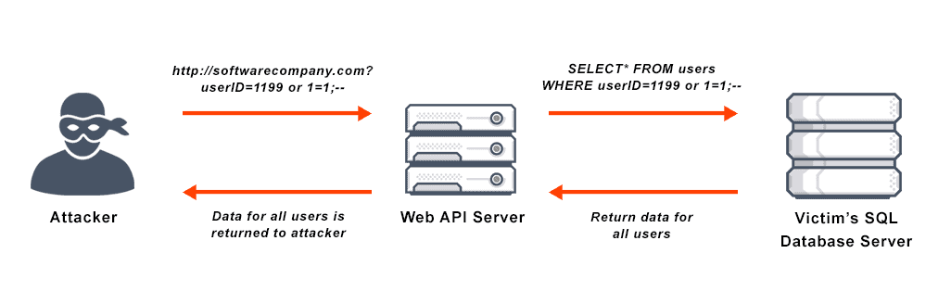
Concept: Content-Based Blind SQLi
Definition: An attack technique that asks the database true/false questions and determines the answer based on the content of the application response.
The Boolean Logic:
TRUE Scenario: ... WHERE id=1 AND 1=1
Result: Page loads normally (e.g., "Welcome, User").
FALSE Scenario: ... WHERE id=1 AND 1=2
Result: Page content changes (e.g., "ID not found" or missing elements).
Inference: By injecting AND substring(password,1,1)='a', if the page loads normally, we know the first letter of the password is 'a'.

Slide 6
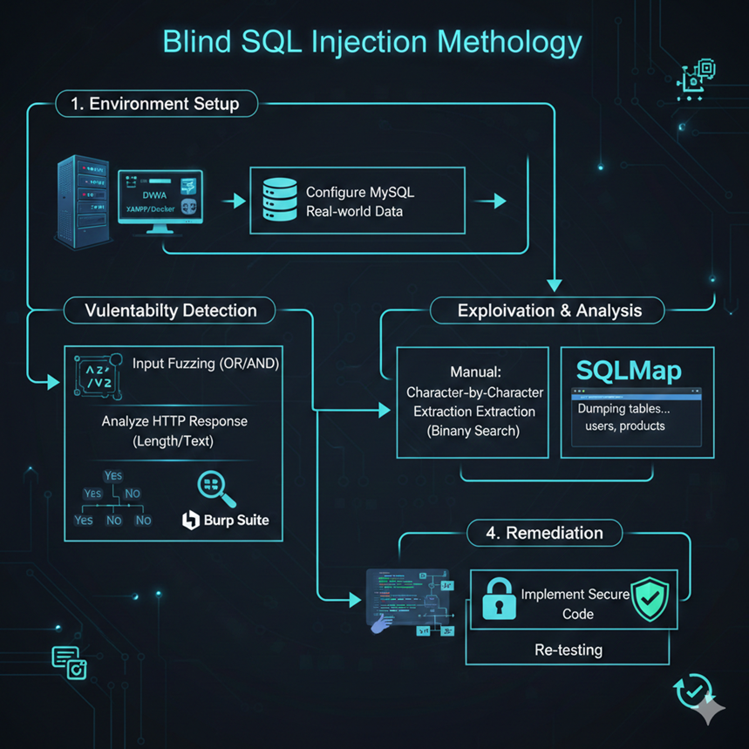
Methodology Proposed
Phase 1: Environment Setup
Deployment of DVWA (Damn Vulnerable Web App) on a local server using XAMPP/Docker.
Configuration of MySQL backend to simulate real-world data storage.
Phase 2: Vulnerability Detection
Input fuzzing using Boolean operators (OR, AND) to identify response anomalies.
Analyzing HTTP response length and visible text changes using Burp Suite.
Phase 3: Exploitation & Analysis
Manual: Character-by-character data extraction (Binary Search method).
Automated: Using SQLMap to dump database tables.
Phase 4: Remediation: Implementing secure code and re-testing.

Slide 7
Manual Exploitation Technique
The "20 Questions" Game:
We cannot ask: "What is the password?"
We can ask: "Is the first letter of the password greater than 'M'?"
The Payload:
id=1' AND (ascii(substr((select user()),1,1))) > 100 #
Observation:
If the page content remains unchanged, the database answered YES.
If the page content disappears, the database answered NO.
Result: By narrowing down ASCII values, we reconstruct the data without ever seeing an error message

Slide 8
Tools Used
Burp Suite (Community Edition):
Used as an HTTP Proxy to intercept requests.
Intruder Module: Automates the fuzzing process to check thousands of Boolean conditions rapidly.
Repeater: Helps in manually verifying the differences in response length.
SQLMap:
Automates the detection of Boolean-based Blind SQLi.
Command: sqlmap -u "target" --technique=B --dbs (B flag specifically targets Boolean-based).
DVWA: The target environment set to "Low" and "Medium" security levels for testing.

Slide 9



Prevention and Countermeasures
Primary Defense: Parameterized Queries (Prepared Statements)
Ensures the database treats user input as data, never as executable code.
Effect: Even if input contains AND 1=1, it is treated as a literal string.
Input Validation:
Implementing strict "Allow-lists" (e.g., only allowing integers for ID fields).
Generic Error Pages:
Ensure the application returns the exact same response regardless of whether a query returns true or false (though this is difficult to implement perfectly without breaking functionality).
WAF (Web Application Firewall): detecting logical operators in input streams. For eg:ModSecurity,cloudfare

Slide 10
Conclusion
Impact: Content-Based Blind SQLi is slower than other methods but highly reliable and stealthy.
Key Finding: The vulnerability exists not in the database software, but in the application code logic that conditionally displays content.
Project Success: Successfully demonstrated the extraction of admin credentials using Boolean logic without triggering database errors.
Final Thought: Security is not just about hiding errors; it is about decoupling user input from database logic completely.

Slide 11
References
OWASP Top 10 – A03:2021 Injection (SQL Injection)
PortSwigger Web Security Academy – Blind SQL Injection Tutorials
CWE-89: Improper Neutralization of Special Elements used in an SQL Command
DVWA Official Documentation
SQLMap GitHub Repository – Usage Guide for Boolean-Based Techniques
Clarke, J. (2009). SQL Injection Attacks and Defense.

